Slide 1
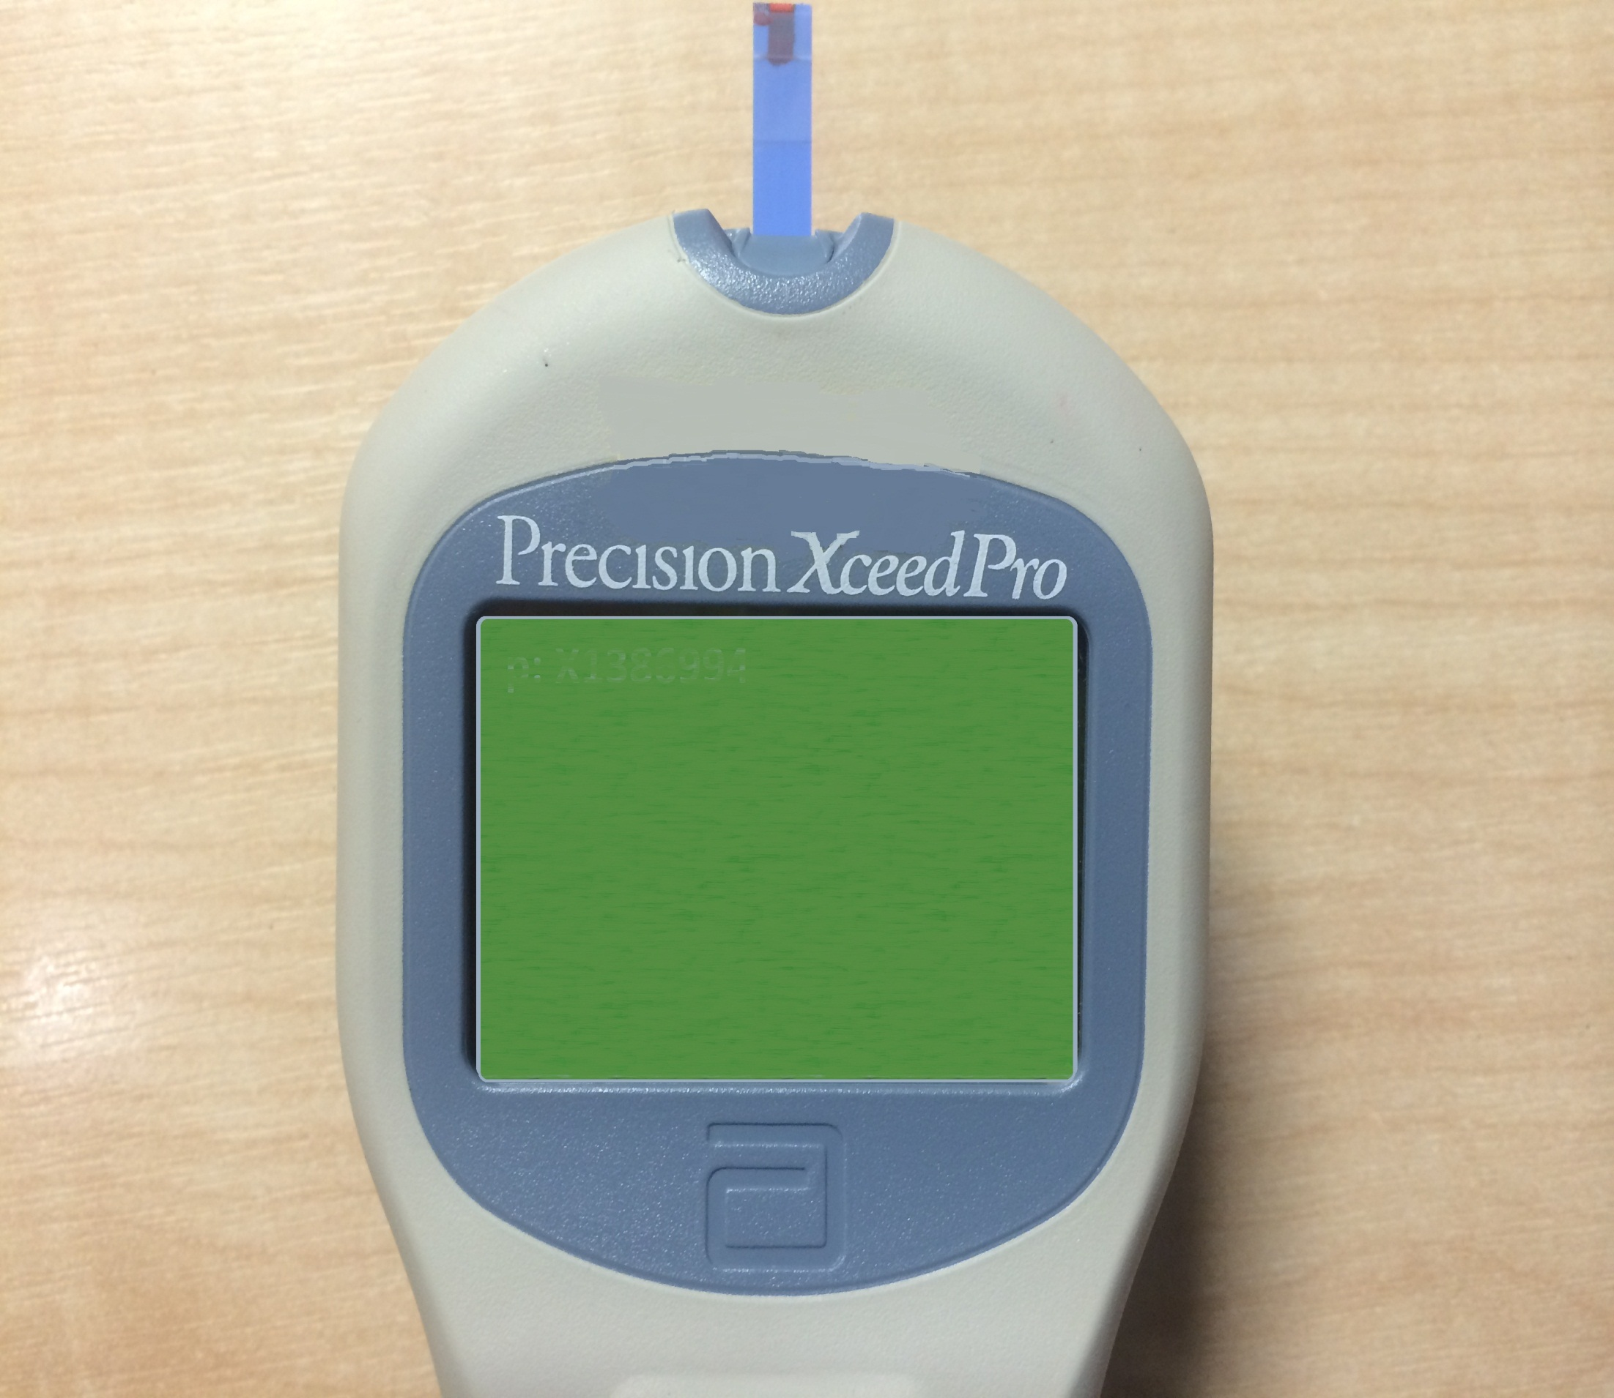
p: X157998
0
mmol/L
Glucose
17/05/15
17:27
1 – Next Patient
2 – Patient History

